Slide 1

Worshop on Agile Software Engineering
Heitor Roriz, MSc.
September 2025

Slide 2
Agility gives us speed, discipline gives us stability, and AI gives us scale — but only engineering principles turn them into lasting value.

Slide 3
What is Agile Software Engineering?
Disciplined practice of building software through iterative, incremental development guided by Agile principles.
Agile principles – bring flexibility and adaptability
Software Engineering – brings robustness, structure
It emphasizes both technical excellence and adaptability
It is about blending Agile values with sound engineering practices to create high-quality software that can evolve quickly and reliably in response to change.

Slide 4
1. Foundations in Agile Values and Principles
Builds on the Agile Manifesto (individuals and interactions, working software, customer collaboration, responding to change).
Software is delivered in small, incremental releases that provide value early and often.
Early and continuous feedback for kaizen and course adjustment
Embraces change as a natural and beneficial part of development.

Slide 5
2. Engineering discipline
Not “just Agile meetings” – it relies heavily on rigorous technical practices such as:
Test-Driven Development (TDD) — writing tests before code to guide design and ensure correctness.
Behavior-Driven Development (BDD) — specifying behavior in business-readable language.
Continuous Integration (CI) — merging changes frequently with automated validation.
Continuous Delivery (CD) — ensuring software is always deployable.
Refactoring — continuously improving code structure without changing behavior.
Pair programming / mob programming — collaborative coding for quality and knowledge sharing.
Clean code and SOLID principles — producing readable, maintainable, and extendable systems.

Slide 6
3. Collaboration and feedback loops
Cross-functional teams (developers, testers, analysts, product owners) work together daily.
Customer collaboration ensures features match real needs.
Feedback loops (reviews, demos, retrospectives) drive continuous improvement in both product and process.

Slide 7
4. Outcomes
Resilient and adaptable codebases that can evolve safely as business requirements change.
Predictable, frequent delivery of valuable features.
Higher quality and lower risk thanks to automation, testing, and discipline.
Sustainable pace of development, avoiding burnout while maintaining productivity.

Slide 8
TypeScript vs. JavaScript
Aspect | JavaScript (JS) | TypeScript (TS)
Typing System | Dynamically typed (types resolved at runtime) | Statically typed (types enforced at compile time)
Type Inference | Limited, mainly typeof and runtime checks | Strong inference + explicit types, interfaces, generics
Error Detection | Errors only surface at runtime | Compile-time checks prevent many runtime errors
Language Features | ES standard (functions, classes, async/await, etc.) | All JS features + types, enums, generics, decorators
Tooling / IDE | Autocomplete based on runtime libraries | Advanced IntelliSense, refactoring, navigation
Compilation | Directly executable by browsers/Node.js | Must be transpiled into JS (via tsc)
Ecosystem | Native everywhere | Superset of JS, integrates with existing JS code
Scalability | More error-prone in large codebases | Designed for large-scale, maintainable applications

Slide 9
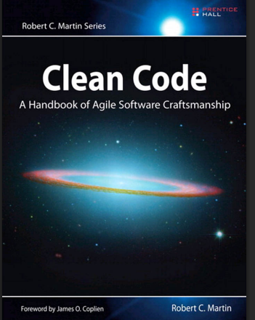
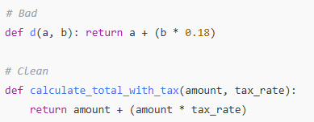
Clean Code: producing readable, maintainable, and extendable code
Meaningful names: variables, functions, and classes describe their purpose.
Small functions: each does one thing well.
Consistent formatting and style: easier to scan and review.

Slide 10
SOLID Principles
S — Single Responsibility: one reason to change.
O — Open/Closed: extend behavior without modifying existing code.
L — Liskov Substitution: subclasses can replace parents without breaking logic.
I — Interface Segregation: clients shouldn’t depend on methods they don’t use.
D — Dependency Inversion: depend on abstractions, not concrete classes.

Slide 11
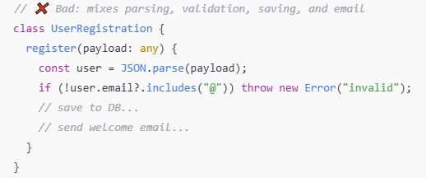
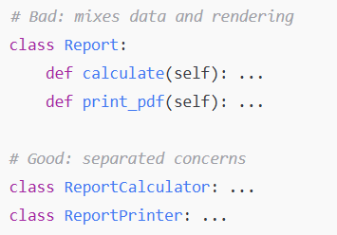
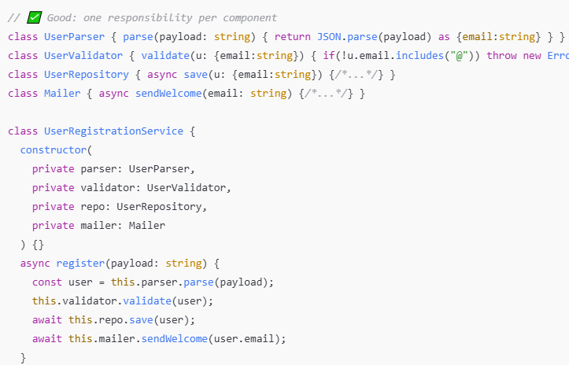
Single Responsibility

Slide 12
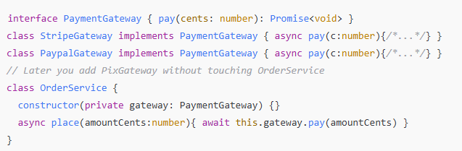
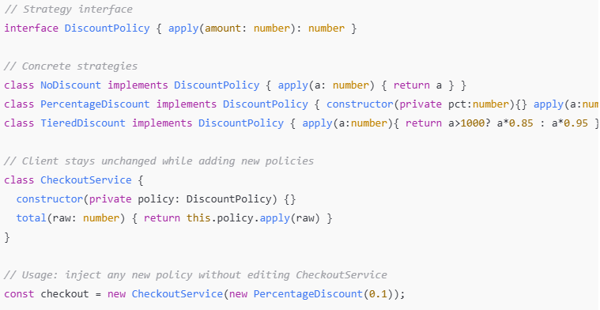
Open/Closed Open for extension, closed for modification (Strategy/Policy)
This is how you implement KSIs!
The interface/abstraction (DiscountPolicy, PaymentGateway) is the stable part — once agreed upon, it rarely changes
The implementations (StripeGateway, PaypalGateway, PixGateway) are the variable parts — you can add or swap them freely without breaking the clients
This separation means clients (like OrderService) depend only on the stable interface, not on the volatile details.

Slide 13
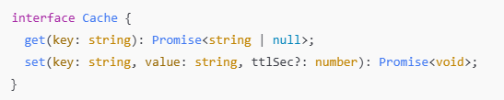
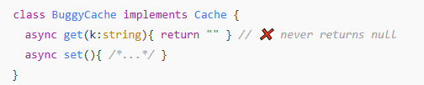

Liskov Substitution (LSP) Subtypes must be replaceable without changing correctness
If B is a subtype of A, then any code using A should work with B without breaking or changing behavior.
In practice: subclasses (or alternative implementations of an interface) must honor the same contract as their parent/interface.
LSP is what makes Known Stable Interfaces reliable.

Slide 14
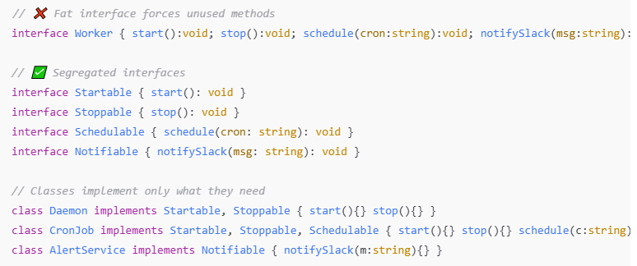
Interface Segregation (ISP) Prefer small, focused interfaces over “fat” ones.
Emulate ISP by exporting small modules (each module = one capability) instead of one giant utility.

Slide 15

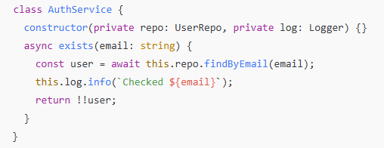

Dependency Inversion (DIP) Depend on abstractions, not concretions. Use constructor injection.
High-level modules (business logic) should not depend on low-level modules (details like databases, loggers, HTTP clients).
Both should depend on abstractions (interfaces/contracts).
This makes the system flexible, testable, and resistant to change.
AuthService does not care if we use Mongo, PostgreSQL, or even an in-memory map:
Here the actual logging and persistence happens:

Slide 16
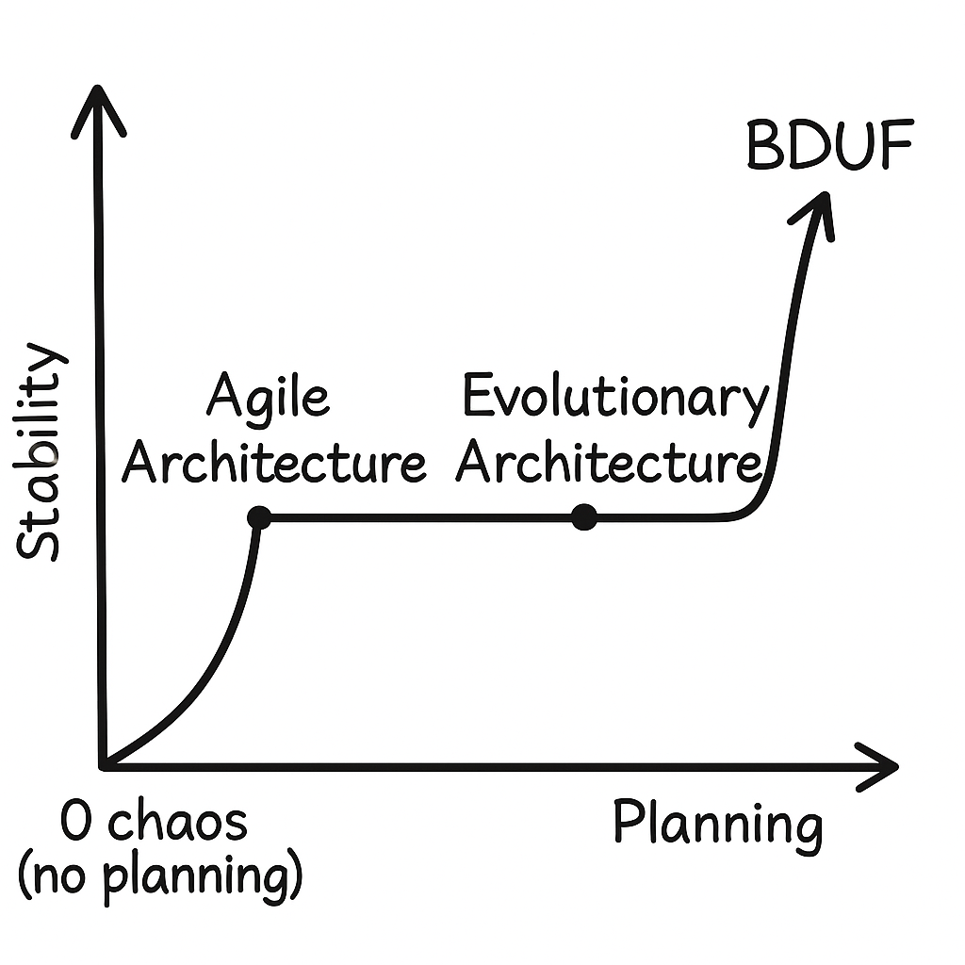
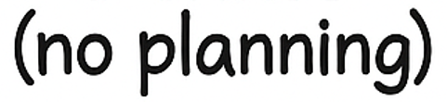

Planning vs. Stability in Software Design
In SW design we want to:
Start building fast
Focus on technical aspects
Not to neglect the whole, but we do

Slide 17
Software development and operation
SDLC
(Software Development Lifecycle)
Coding
Build
Integration
Test
Release
Deploy
Operation
Agile Development
Continuous Integration - CI
Continuous Delivery
Continuous Deployment - CD
DevOps

Slide 18
What changed in SW Engineering with Agile?
Coding
Build
Integration
Test
Release
Deploy
Operation
Test
Test
Test
Sprint 1
Discover
Sprint 2
Discover
Sprint 3
Discover
Develop
Develop
Develop
Design
Design
Design

Slide 19
Sequential and constant deliveries
Test
Test
Test
Sprint 1
Discover
Sprint 2
Discover
Sprint 3
Discover
Develop
Develop
Develop
Design
Design
Design
Release
Deploy
Operação
Release
Deploy
Operação
Final product
Preparation
Release Planning
sprint 1
sprint 2
sprint 3
sprint n
Discovery
PoCs
Infrastructure
Initial Backlog
Estimates
Release Plan
Incremental delivery in sequential iterations

Slide 20
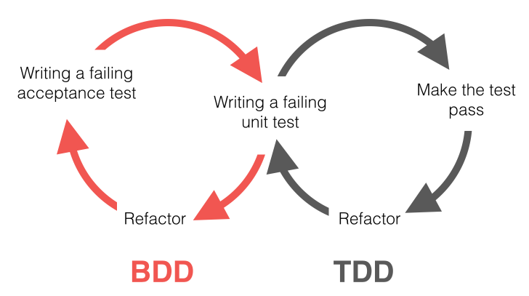
Developing with TDD and BDD
Feature description in the form of User Stories
Acceptance criteria (business satisfaction conditions)
As a Diamond customer, I need to search for flights so that I can spend Christmas with my family.
The search results must be displayed in 7 seconds or less.
The user can search without logging in.
The system must offer filters by price and airline.
…
...
...
...
...
...
...

Slide 21
Developing with TDD and BDD
Feature description in the form of User Stories
Acceptance criteria (business satisfaction conditions)
As a Diamond customer, I need to search for flights so that I can spend Christmas with my family.
The search results must be displayed in 7 seconds or less.
The user can search without logging in.
The system must offer filters by price and airline.
…
...
...
...
...
...
...

Slide 22
Developing with TDD and BDD
Feature description in the form of User Stories
Acceptance criteria (business satisfaction conditions)
As a Diamond customer, I need to search for flights so that I can spend Christmas with my family.
The search results must be displayed in 7 seconds or less.
The user can search without logging in.
The system must offer filters by price and airline.
…
...
...
...
...
...
...

Slide 23

Developing with TDD and BDD
Feature description in the form of User Stories
Acceptance criteria (business satisfaction conditions)
As a Diamond customer, I need to search for flights so that I can spend Christmas with my family.
The search results must be displayed in 7 seconds or less.
The user can search without logging in.
The system must offer filters by price and airline.
…
...
...
...
...
...
...

Slide 24
Agile and AI give us speed. Engineering gives us trust. Together, they shape the future of software.

Slide 25
TDD viability: when it pays off (and when it doesn’t)
Use TDD for “foundational code”:
Core domain logic, invariants, business rules
Algorithms you’ll extend or optimize
Modules with tricky edge cases or concurrency/async behavior
Public APIs / Known Stable Interfaces
Usually skip TDD (write tests after or use BDD only):
Spikes/prototypes, throwaway explorations
Thin UI layers where behavior is mostly visual
Heavy I/O glue where end-to-end tests give better ROI

Slide 26
Decision heuristics (quick checklist)
Will this module live > 3 months and be reused? → TDD
Will bugs here be expensive or reputation-damaging? → TDD
Are edge cases hard to reason about? → TDD
Is it mostly formatting/wiring? → Probably not TDD

Slide 27
Business case (how to explain to management in general):
TDD shifts defect discovery to minutes, not sprints
Enables fearless refactoring – faster feature lead time over quarters
Reduces onboarding cost: tests explain intent of the code

Slide 28
BDD for user stories (do it for every story)
Why BDD, always for stories:
Turns acceptance criteria into living specs
Aligns devs, QA, and stakeholders on behavior (ubiquitous language)
Lets you evolve UI/implementation without losing intent
Given-When-Then pattern (fast rules):
Given: preconditions/business state
When: user action or event
Then: observable outcome (business-verifiable)
Mapping in NodeJS stack:
Gherkin (.feature) → step definitions (Cucumber.js)
Wire steps to app services or API (supertest) and, where needed, browser-level (Playwright) for end-to-end

Slide 29
BDD Mapping in NodeJS stack
Gherkin (.feature) → step definitions (Cucumber.js)
Wire steps to app services or API (supertest) and, where needed, browser-level (Playwright) for end-to-end
Good BDD smells to avoid:
UI pixel assertions in BDD (keep those in visual tests)
Over-mocking in acceptance tests (prefer running against real app/API or a realistic in-memory adapter)

Slide 30
The future codebase: ratios, pyramid, and quality gates (1)
What will the codebase look like once we use TDD for critical aspects and BDD for every user story?
Test Pyramid target:
Unit (fast): ~70% of tests
Service/integration: ~20–25%
E2E/UI: ~5–10% (high value paths only)
LOC ratio (guideline, not a KPI):
Healthy mature systems: 1:1 to 2:1 (test : production LOC)
Closer to 1:1 when domain is simple/CRUD-heavy
Up to 2:1 when domain logic is complex or safety critical

Slide 31
The future codebase: ratios, pyramid, and quality gates (2)
Test coverage KPIs:
80% of our lines run in tests – ensures most of the code is executed by tests
70% of our if/else paths are tested – ensures decision logic (ifs/switches) is really exercised
70% of injected bugs are caught – ensures tests aren’t just running code but are strong enough to catch real bugs.
That’s how we know our tests aren’t just theater
Quality gates in CI:
All tests green in < 5 minutes
Lint + type check (if TS) + unit tests on every PR
Nightly: full integration/E2E suite

Slide 32
Definition of Done (our quality perception/standard)
If you don’t have a laid-out DoD, create one now to start using tomorrow.
Definition of done (to be appended to your existing one)
Story has BDD scenarios implemented
New/changed domain logic covered by TDD unit tests
Tests read like documentation (names express business rules)

Slide 33
Future Work: Test Coverage KPIs & Advanced Tooling (examples of state-of-the-art tools)
Test Coverage KPIs
Line ≥ 80% → most of the code is exercised
Branch ≥ 70% → different paths (ifs/switches) are tested
Mutation ≥ 70% → tests strong enough to catch real bugs
Advanced Testing Tools (beyond TDD/BDD basics)
Unit level: Jest/Sinon, Mockito (mocking dependencies)
Service/API: WireMock, MockServer, MSW, Nock (simulate APIs)
Contracts: Pact / Spring Cloud Contract (keep mocks honest)
Infra realism: Testcontainers, LocalStack, Azurite (real DBs/queues/clouds in Docker)
Visual checks: Percy / Playwright snapshots (UI regressions)

Slide 34
Why is this necessary? The Test Pyramid
End-to-End UI
~5-10% tests
Tools: Cypress, Playwright, Percy
Service/Integration
~20-25% tests
Tools: WireMock, MockServer, Pact
Unit (TDD)
~70% tests
Tools: Jest, Sinon, Mockito

Slide 35
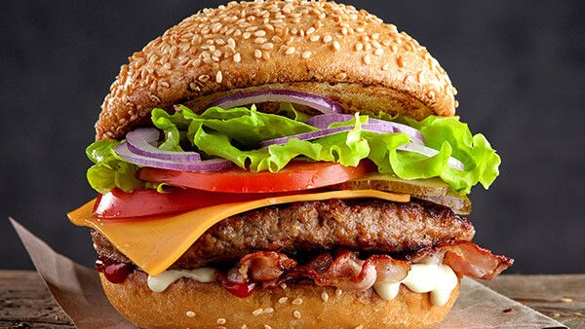
Why is this necessary? The Burger Method

